Slide 1
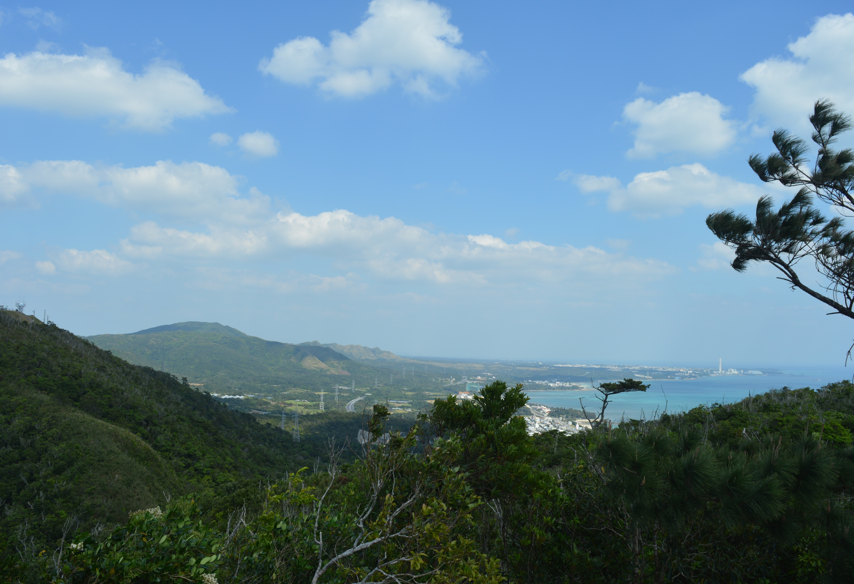

Sam Ross (He/Him)
s.ross.res@outlook.com
Exploring the biotic drivers of ecological stability through a global collaborative network
Samuel R.P-J. Ross¹, Owen L. Petchey², The Response Diversity Network
¹OIST, Japan
²University of Zurich, Switzerland
@SamRPJRoss
www.samuelrpjross.com
Notes:
Sam Ross, Postdoctoral Scholar @ OIST
Going to discuss the benefits of global collaborative networks for advancing stability research

Slide 2
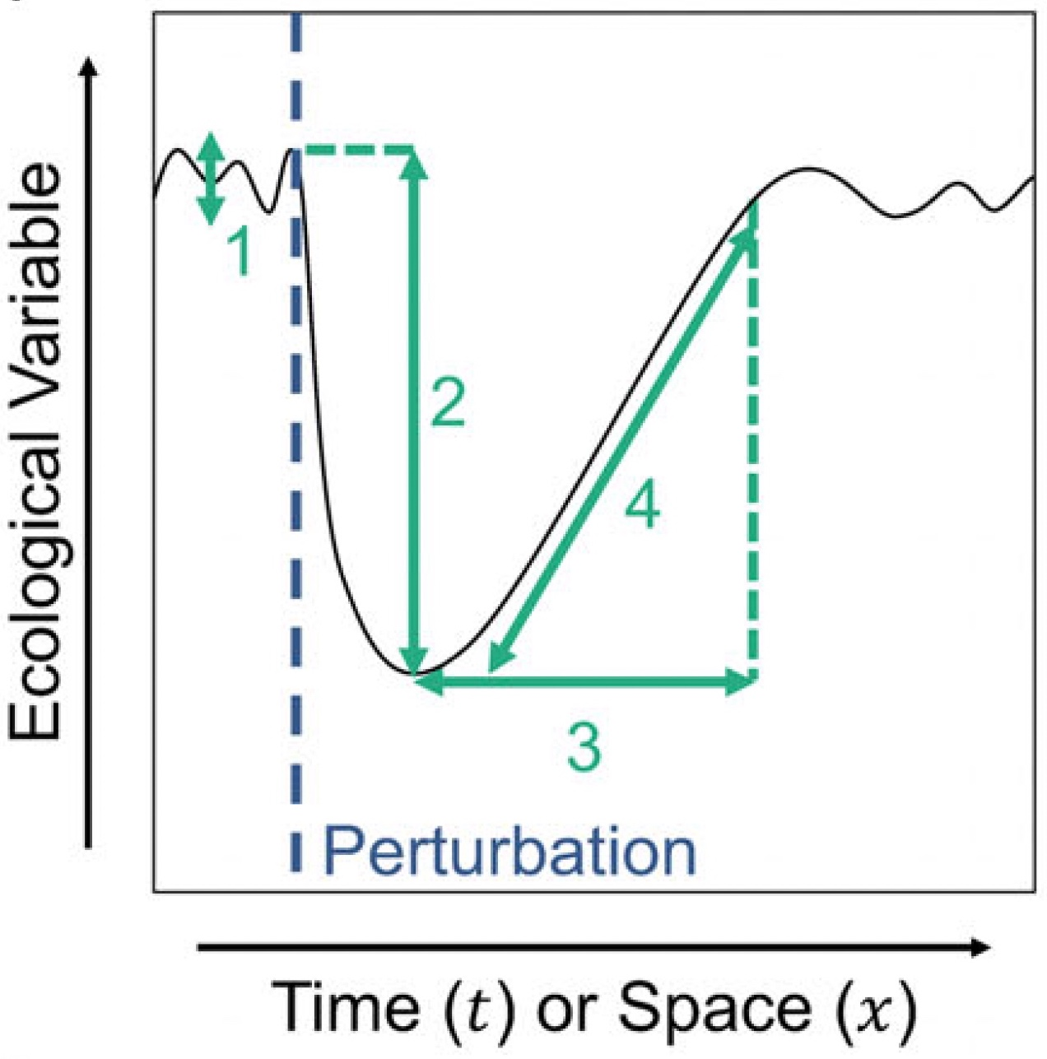
Ecological Stability
“…the central framework to understand an ecosystem's ability to absorb or recover from environmental change.”
Hillebrand et al. (2018) Ecology Letters
“…a complex and multifaceted concept, including components such as variability, resistance, resilience…”
Donohue et al. (2013) Ecology Letters
Ross, Suzuki et al. (2021) Ecological Research
@SamRPJRoss
www.samuelrpjross.com
Notes:
What is stability and why does it matter? READ
Concept is complex and multidimensional including READ

Slide 3
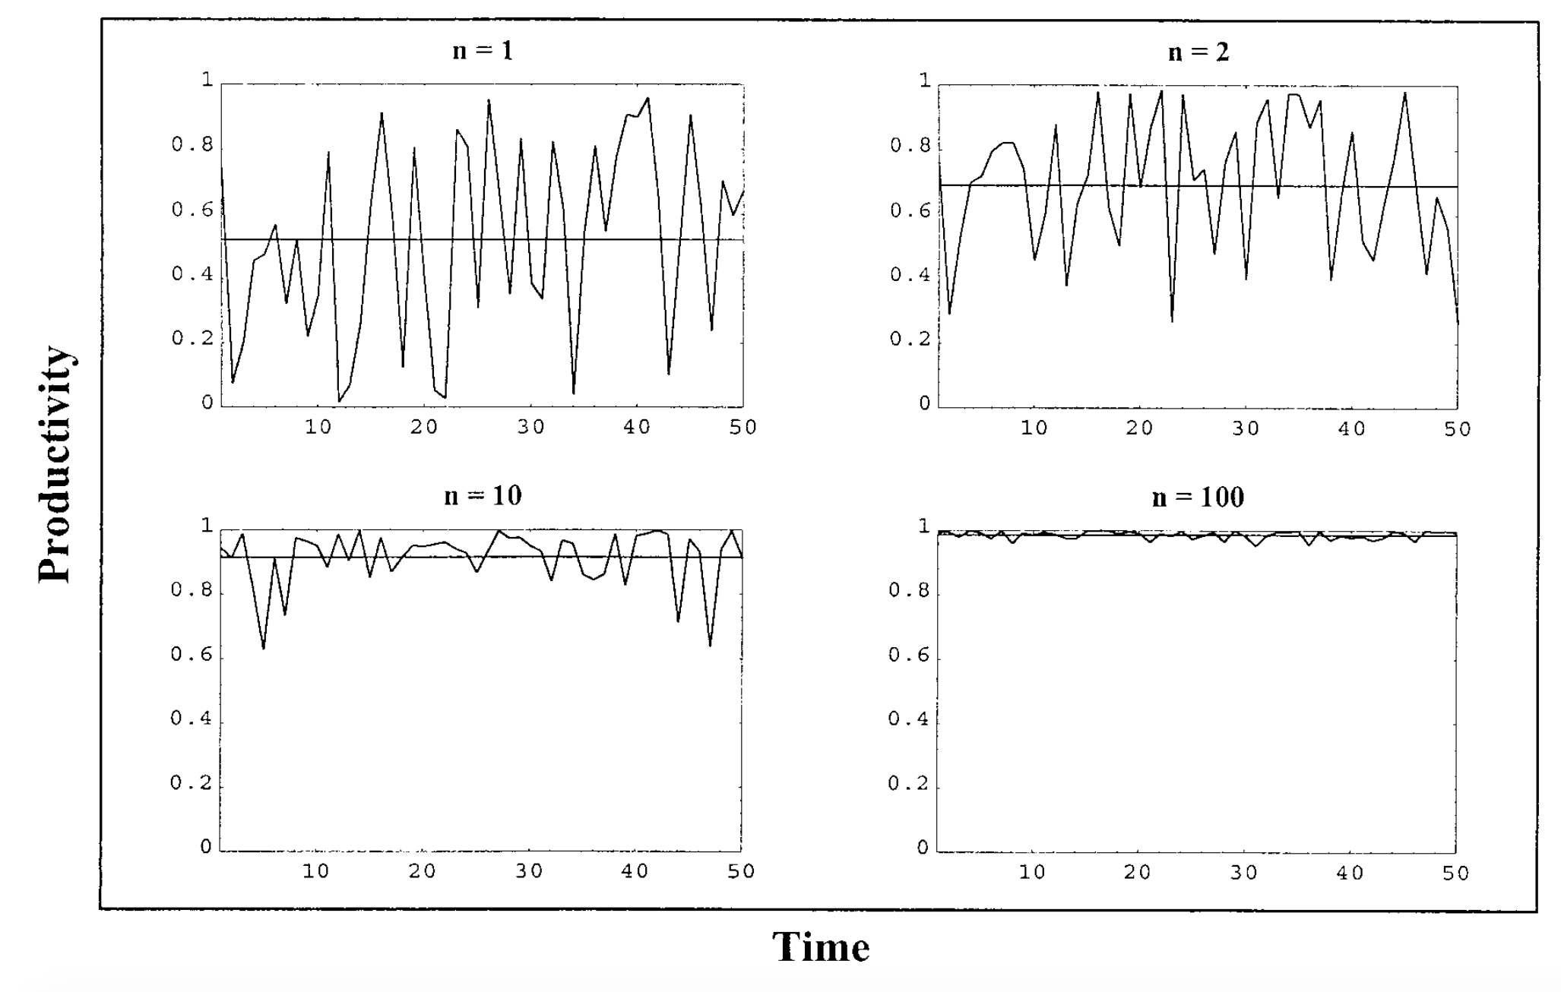
1 species
2 species
Simulated productivity
10 species
100 species
Diversity-stability
B-EF
Time
The Insurance Effect of biodiversity: biodiversity both increases and stabilises ecosystem functioning
Yachi & Loreau (1999) PNAS
@SamRPJRoss
www.samuelrpjross.com
Notes:
- Under Insurance effect: we know Biodiversity increases and stabilises. - Lots of work on B-EF relationship (increase part), here we focus on stabilising part (diversity-stability)

Slide 4
Why does biodiversity increase stability?
Portfolio effect/ compensatory dynamics/ community asynchrony:
In diverse communities, declines of one species more likely to
be offset by neutral/positive responses of others.
Sp. 3
Sp. 2
Temporal Stability (1 – variability)
Population Size
Sp. 1
Biodiversity
(Species richness, functional diversity, etc.)
Time
@SamRPJRoss
www.samuelrpjross.com
Notes:
We often see different elements of biodiversity increasing stability, but WHY?
Portfolio effect/compensatory dynamics/community asynchrony – READ
Means as species added to a community, more likely that additional species have different dynamics/respond differently

Slide 5
1 species
2 species
Simulated productivity
10 species
100 species
Diversity-stability
Time
Is there a unifying framework to capture the processes underlying the Insurance Effect of biodiversity?
Yachi & Loreau (1999) PNAS
@SamRPJRoss
www.samuelrpjross.com
Notes:
So biodiversity tends to be stabilising – but what is it about biodiversity that’s stabilising?
Want a unifying framework to capture closely related ideas around stabilising processes

Slide 6


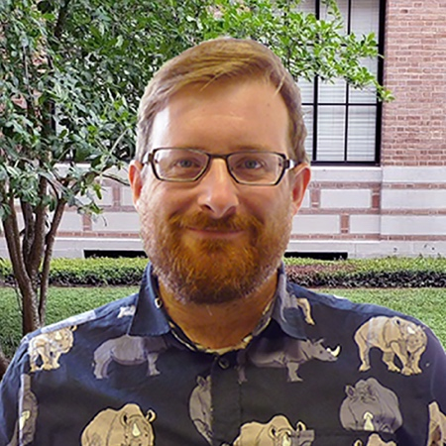

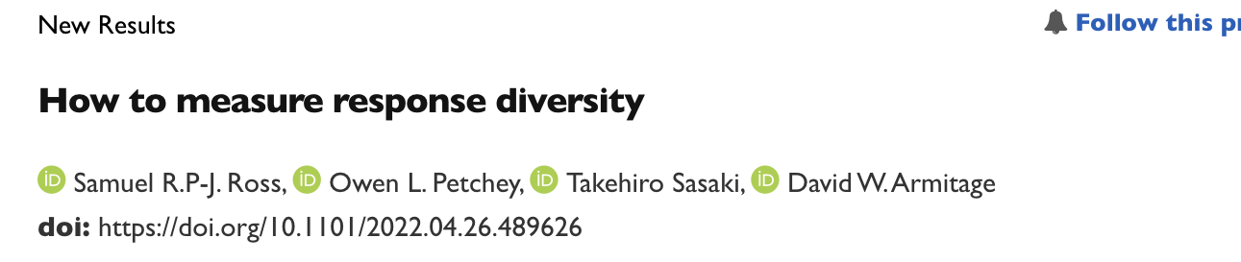
Response Diversity
Owen Petchey U. Zurich
Takehiro Sasaki Yokohama Nat’l U.
Dave Armitage OIST
“…the range of responses to the environment displayed among species in a community”
Ross et al. (2023) Methods in Ecology and Evolution
@SamRPJRoss
www.samuelrpjross.com
Notes:
We think RESPONSE DIVERSITY is a useful framework for thinking about the drivers of stability.
Defined as READ
We have a first paper about this, out now in MEE

Slide 7
“Few empirical studies have explicitly measured response diversity.”
Ross et al. (2023) Methods in Ecology and Evolution
A global and collaborative approach to response diversity research should accelerate progress, and prevent response diversity from being overlooked.
@SamRPJRoss
www.samuelrpjross.com
Notes:
We reviewed literature and found READ
- So to make sure response diversity isn’t overlooked, we think a global and collaborative approach to RD research should help.

Slide 8








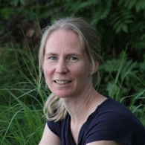
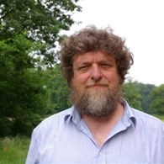

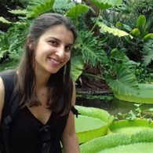

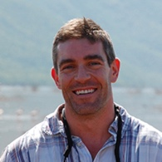




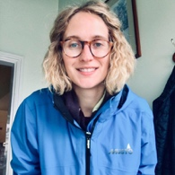



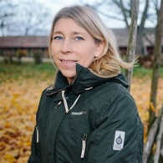

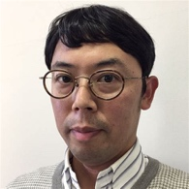




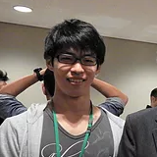




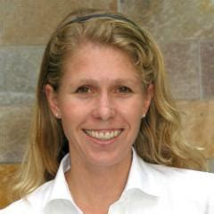




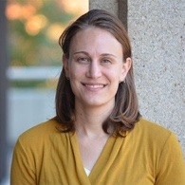


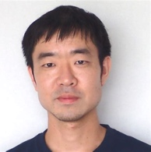
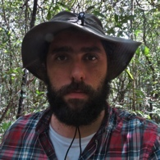



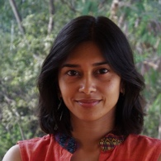


















64 members from 45 institutions in 22 countries
@SamRPJRoss
www.samuelrpjross.com
Notes:
So we started the response diversity network for any researchers interested in the drivers of stability, and particularly response diversity.
Currently we have 64 members from 45 institutions across 22 countries. Always open to new members if anyone is interested in joining.
Now show you some of the work on this topic that we’re developing within the network. Just starting out, but more to come in future! Talk more about longer-term goals of network towards end.

Slide 9
Measuring Response Diversity
Ross et al. (2023) Methods in Ecology and Evolution
@SamRPJRoss
www.samuelrpjross.com
Notes:
Start with our review of methods for measuring response diversity empirically.
Broadly there are 2 ways of measuring response diversity – either using low-level traits like leaf size, or high-level traits like population growth rate.

Slide 10
Response trait diversity
Ross et al. (2023) Methods in Ecology and Evolution
@SamRPJRoss
www.samuelrpjross.com
Notes:
Most empirical studies of response diversity use low-level traits that don’t always directly relate to species’ responses to the environment.
They measure the functional diversity of response traits.
Though an indirect estimate of species’ responses, these methods can be useful for revealing relationships with stability.

Slide 11
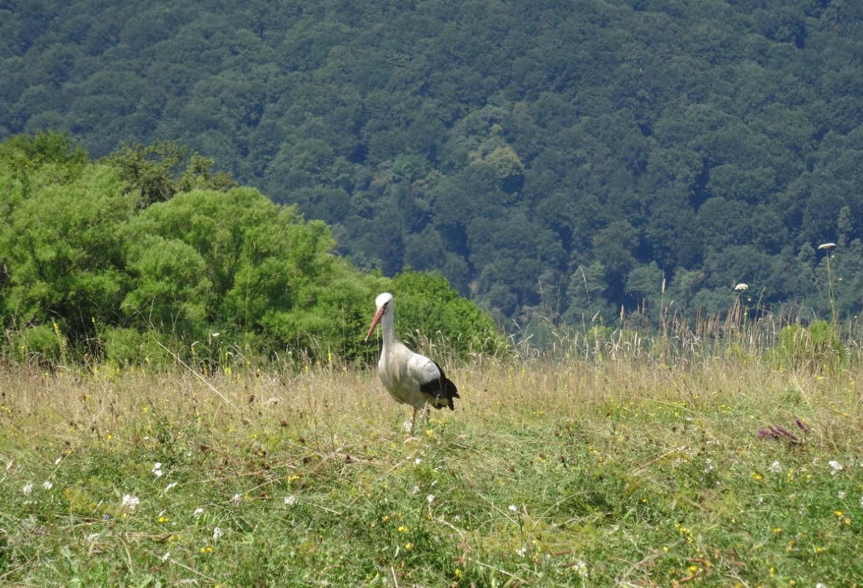
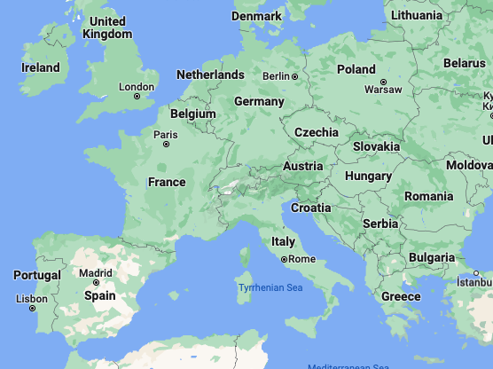

Romanian birds
5+ years of bird community data (species abundances)
@SamRPJRoss
www.samuelrpjross.com
Notes:
Here’s an example using time series of bird communities in Romania, central Europe.

Slide 12

Romanian birds
Hannah White
Anglia Ruskin Uni.
Traits
Asynchrony
Stability
White et al. (In revision)
@SamRPJRoss
www.samuelrpjross.com
Notes:
This work led by Hannah White finds response trait diversity relates to stability – but the strongest effect is indirect, through the effect of response trait diversity on species asynchrony.

Slide 13
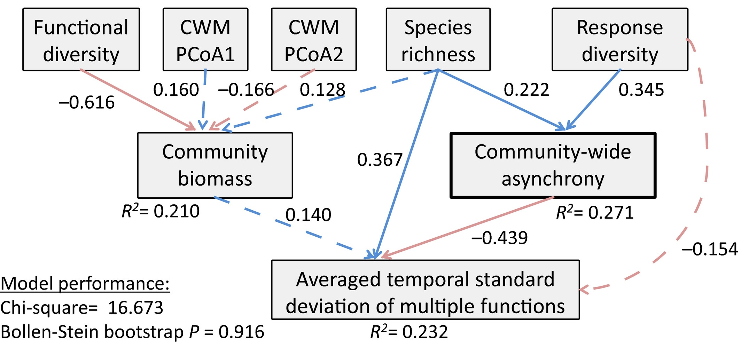
Mongolian plants
Takehiro Sasaki Yokohama Nat’l U.
Traits
Asynchrony
Stability
Sasaki et al. (2019) Journal of Ecology
@SamRPJRoss
www.samuelrpjross.com
Notes:
Interestingly, Takehiro Sasaki and colleagues found same pattern in grassland data from Mongolia.
Response traits affected temporal stability of functioning, but only indirectly through community asynchrony! So Rdiv seems to affect asynchrony across different systems.

Slide 14
Performance-environment relationships
Ross et al. (2023) Methods in Ecology and Evolution
@SamRPJRoss
www.samuelrpjross.com
Notes:
Those were studies using low-level traits, but we can also use high-level traits - like population growth rate or carrying capacity - which should be more directly related to environmental change and stability.

Slide 15

Leary & Petchey (2009) J. Anim. Ecol.
Take derivatives of species-environment relationships.
Method can handle nonlinear responses (temperature-dependency).
r
K
Environment-stability relationships driven by underlying biotic environmental dependencies?
Ross et al. (2023) Methods Ecol. Evol.
@SamRPJRoss
www.samuelrpjross.com
Notes:
This is an example using higher level traits to measure response diversity. Original study is from Leary & Petchey using aquatic ciliates in microcosms - Measured responses of species to temp for r and K
Our method calculates the derivatives of species-environment relationships – that means how the slope of the relationship changes along the x-axis
This method can handle nonlinear responses – where temperature affects response diversity (which is what we see here).
-Environment-dependent response diversity is interesting – when stability varies with environment, should be driven by underlying changes in biotic responses with environment

Slide 16

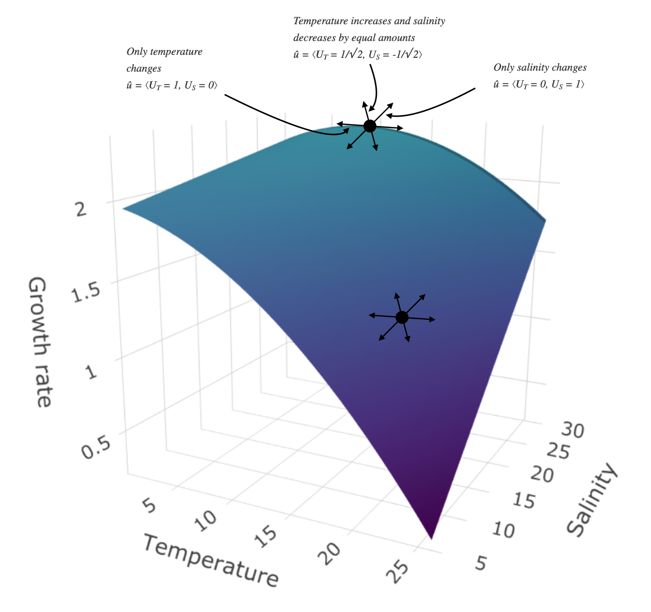
Multiple stressors
Temperature AND Salinity change
Salinity change
Francesco Polazzo
Uni. Zurich
Temperature change
How can we consider response diversity to multiple environmental changes simultaneously?
Requires multidimensional response surface and understanding of direction of environmental change.
Polazzo et al. (In prep.)
@SamRPJRoss
www.samuelrpjross.com
Notes:
So far, we've been talking about responses to a single environmental condition
But in most cases, species and communities are exposed to multiple environmental stressors at the same time. So how can we measure response diversity using higher-level traits in cases where there are multiple interacting environmental conditions?
Francesco Polazzo leading this project as member of Network.
Methods are quite heavy but require constructing multidimensional response surfaces and considering the direction of environmental change along each axis.

Slide 17
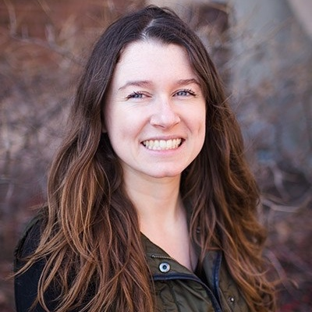
Expert opinion polling
Send to Response Diversity Network and authors of response diversity papers.
Survey aims
CONCEPT
Understand what people currently consider response diversity to be.
INTEREST
Understand why people are interested in response diversity.
METHODS
Reveal how people are currently measuring response diversity.
HOT TOPICS
Reveal the challenges and priorities in terms of research and application.
MANDATE
Inform the agenda and goals of the Response Diversity Network.
Laura Dee
U. Colorado Boulder
@SamRPJRoss
www.samuelrpjross.com
Notes:
Laura Dee is also leading the development of a survey - so we can poll experts, members of the network and authors, about their ideas about response diversity.
The survey aims to READ

Slide 18
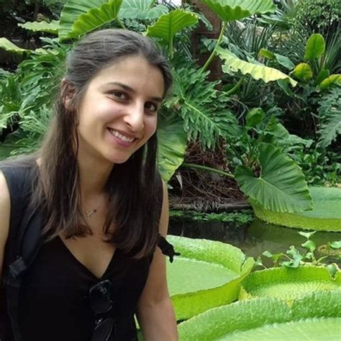
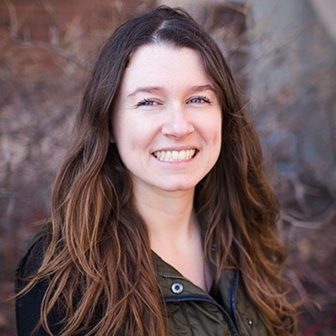


Objectives
RESEARCH
Organise and accelerate scientific advances about response diversity and stability.
MONITORING
Promote the inclusion of response diversity in monitoring and assessment of biodiversity change.
RESOURCE
Provide clear and accessible information about response diversity to relevant individuals and organisations.
Steering committee
Ceres Barros
Laura Dee
Mike Fowler
Owen Petchey
Sam Ross
Takehiro Sasaki
Hannah White
Objectives are flexible and should evolve to
meet the needs of the network over time.
@SamRPJRoss
www.samuelrpjross.com
Notes:
We formed the network, including a steering committee to help set the direction of the network.
Current objectives of RDN are to READ
But these objectives aren't static - they're flexible and should evolve as the network does.

Slide 19
Longer-term goals
Global synthesis
+ve
Study
-ve
Effect size (stability ~ diversity)
@SamRPJRoss
www.samuelrpjross.com
Notes:
The Network is still new, but longer-term, there will be opportunity to coordinate a global synthesis – a meta-analysis of response diversity – stability studies.

Slide 20
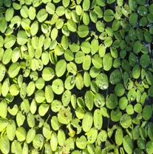
Longer-term goals
Distributed experiment
Stability
Response diversity
@SamRPJRoss
www.samuelrpjross.com
Notes:
Alternatively, we could set up some kind of distributed experiment – aiming to test how response diversity relates to stability across different contexts.

Slide 21
Longer-term goals
Global synthesis
Distributed experiment
@SamRPJRoss
www.samuelrpjross.com
Notes:
Global networks or big international collaborations tend to do either a synthesis or an experiment, but rarely (if ever) both. We could potentially compare the results of these two approaches if we did both – this would take a large amount of effort, though.

Slide 22
Ross et al. (2023) Methods in Ecology and Evolution
Response diversity should predict ecological stability (Insurance Hypothesis)
Different approaches for conceptualising and quantifying response diversity.
By coordinating and accelerating research, the Response Diversity Network has the potential to be a useful community resource.
@SamRPJRoss
www.samuelrpjross.com
Notes:
To summarise, READ

Slide 23





Nago, Okinawa
Thank you
Owen Petchey
Takehiro Sasaki
Dave Armitage
Hannah White
Laura Dee
Mike Fowler
Ceres Barros
Francesco Polazzo
Gavin Simpson
Frank Pennekamp
Joseph Bailey
Ciortan Bogdan
…and
@SamRPJRoss
Email: s.ross.res@outlook.com
Notes:
With that, thank coauthors on our MEE paper, RDN steering committee, and everyone who contributed to the work here.

Slide 24
64 members from 45 institutions in 22 countries
…and You?
@SamRPJRoss
Email: s.ross.res@outlook.com
Notes:
End with quick plug to join RDN.
Coordinating research on response diversity and stability. Early phase, but please let me know if you’d like to know more/ be added to the mailing list.

Slide 25



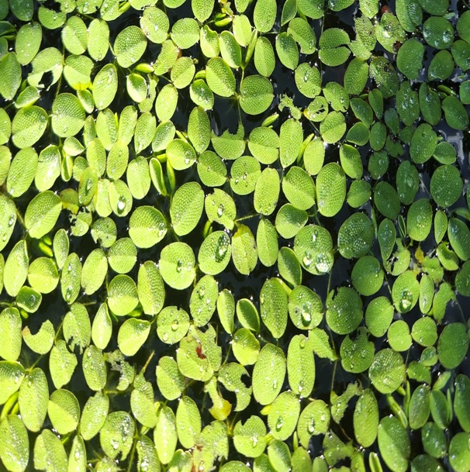
Experiment on response diversity and
stability of floating plants
Hiring: Research Assistant
求人：研究助手
Jun (六) – Aug (八) 2023
Dave Armitage OIST
沖縄
Nitrogen
窒素
75 mesocosms
メソコスム
Floating plants
浮遊植物
@SamRPJRoss
Email: s.ross.res@outlook.com
Notes:
This summer, we will also do an experiment on response diversity and stability using mesocosms of floating plants. We are currently hiring a paid research assistant to come and work with us on this project in Okinawa. So please contact me for more information or to apply.

Slide 26
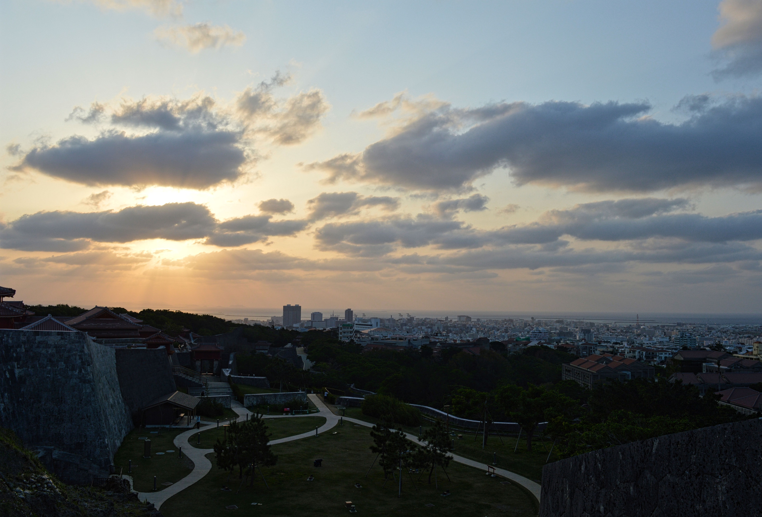
21/03 (火) 14:40
第11回 日本生態学会奨励賞（鈴木賞）
地球環境変動下における生態系の安定性の規則性と原動力の解明に用いる統合的手法
Integrative approaches for understanding the patterns and drivers of ecological stability under global environmental change
@SamRPJRoss
Email: s.ross.res@outlook.com
Notes:
Finally, I will be giving a Suzuki-sho lecture on Tuesday in Sendai, and I hope you will join to hear more about stability and acoustic monitoring if you’re interested in hearing about the other aspects of my work.

